Slide 1
Applied Cryptography proof of work, bitcoin transaction syntax, bitcoin scripting language
LiangFeng Zhang
zhanglf@shanghaitech.edu.cn
ShanghaiTech

Slide 2
Incentive-Based Protections in Bitcoin
Protection against invalid TXs is cryptographic.
enforced by consensus: if a node does attempt to include a crypto invalid TX, then the only reason that TX won’t survive is because a majority of the nodes are honest and won’t include an invalid TX in the blockchain.
Protection against double spending is by consensus.
consensus determines valid TX/double spend TX will not survive
Why will the nodes perform honestly?
Reward the nodes that created blocks that eventually survive
Block Reward: The proposer of a block can include a special TX
This TX is a coin-creation TX, analogous to CreateCoins in Scroogecoin,
The node can choose the recipient address of this TX
As of 2015, 25 bitcoins; halves with every 210000 blocks (4 yrs) created
The only way in which new bitcoins can be created
Transaction Fees: sum of TX inputs – sum of TX outputs
creator of any TX: sum of TX outputs < sum of TX inputs
If you put the TX into a block, you collect the difference

Slide 3
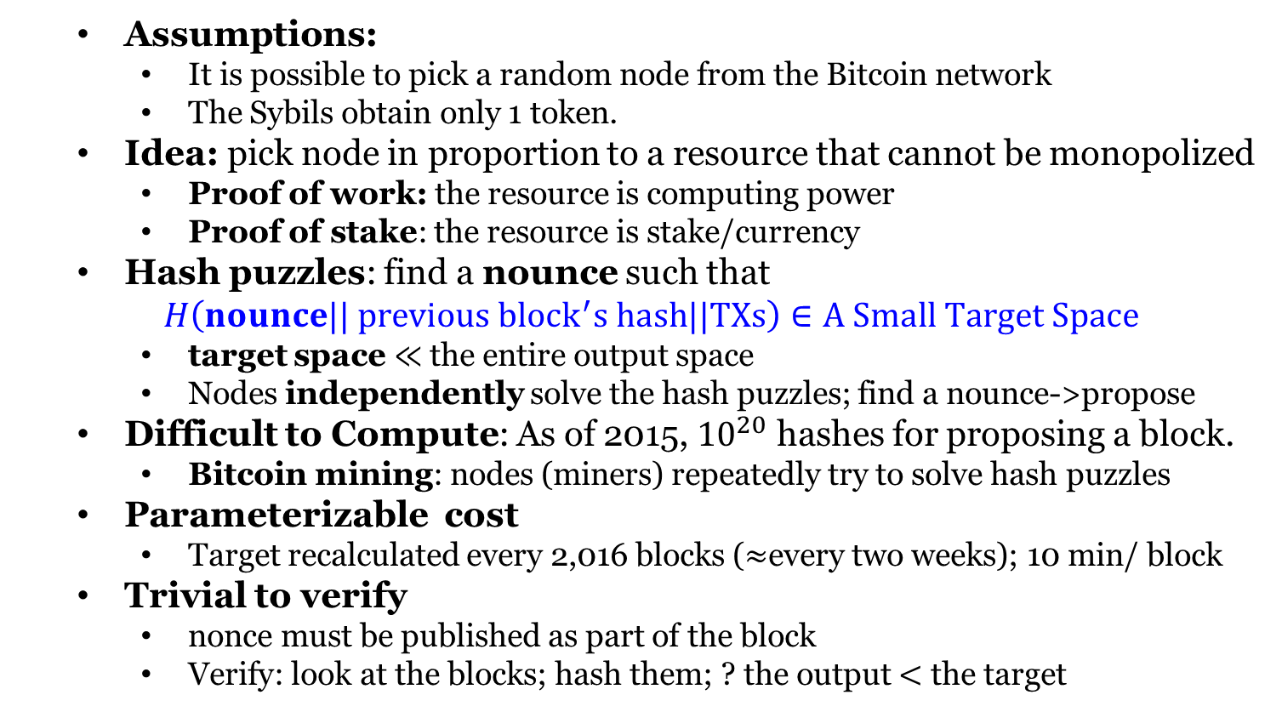
Proof of Work (PoW)
Assumptions:
It is possible to pick a random node from the Bitcoin network
The Sybils obtain only 1 token.
Idea: pick node in proportion to a resource that cannot be monopolized
Proof of work: the resource is computing power
Proof of stake: the resource is stake/currency
Hash puzzles: find a nounce such that
$H\left(nounce|| previous {block}^{′}s hash||TXs\right)∈A Small Target Space$
target space $≪$ the entire output space
Nodes independently solve the hash puzzles; find a nounce->propose
Difficult to Compute: As of 2015, ${10}^{20}$ hashes for proposing a block.
Bitcoin mining: nodes (miners) repeatedly try to solve hash puzzles
Parameterizable cost
Target recalculated every 2,016 blocks ($≈$every two weeks); 10 min/ block
Trivial to verify
nonce must be published as part of the block
Verify: look at the blocks; hash them; ? the output $<$ the target

Slide 5
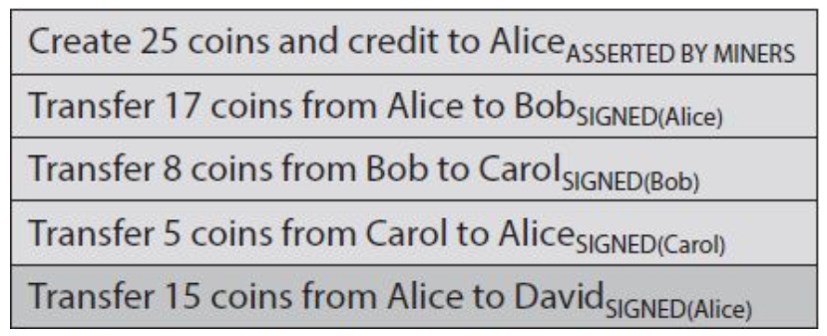
Account-Based Ledger
A TX is like “move 17 coins from Alice to Bob” and signed by Alice
determine is a TX is valid? keep track of these account balances
Account-Based Ledger

Slide 6
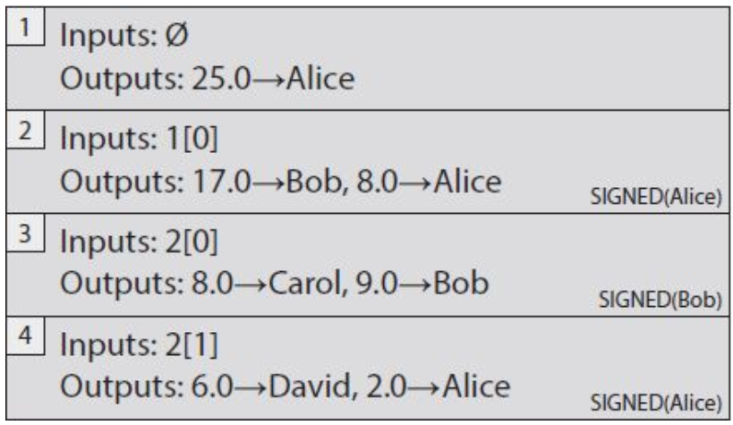
Transaction-Based Ledger
TXs specify a number of inputs and a number of outputs
Unique TX ID; Inputs: coins being spent; Outputs: coins being created
TX-Based Ledger
TX1: new coins are created; No inputs, no signature
TX2: Spend the output 0 of the TX 1; Send 17 to Bob and 8 to Alice
change address: Alice needs a new address for the 8 coins
Verification: the input has 25 bitcoins; hasn’t been spent

Slide 7
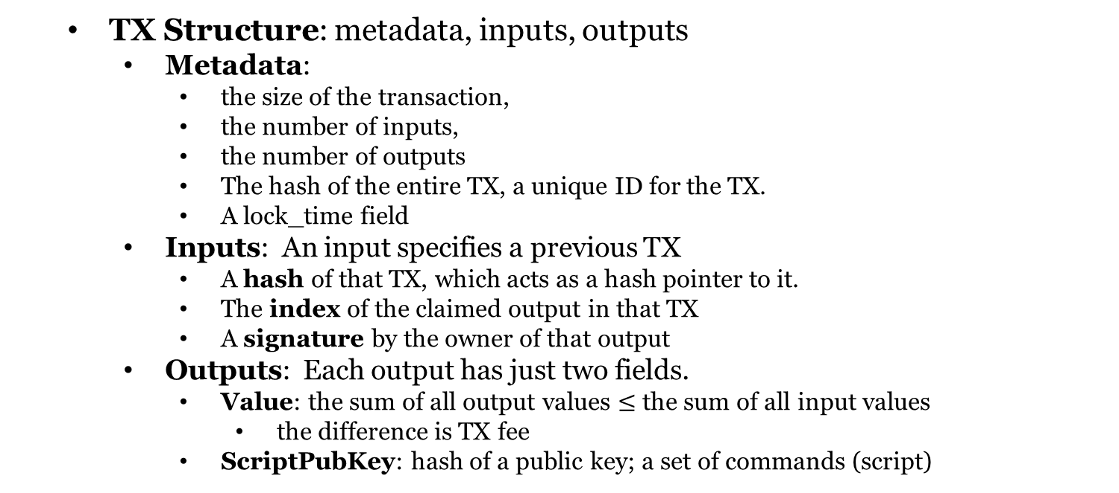
Transaction Syntax
TX Structure: metadata, inputs, outputs
Metadata:
the size of the transaction,
the number of inputs,
the number of outputs
The hash of the entire TX, a unique ID for the TX.
A lock_time field
Inputs: An input specifies a previous TX
A hash of that TX, which acts as a hash pointer to it.
The index of the claimed output in that TX
A signature by the owner of that output
Outputs: Each output has just two fields.
Value: the sum of all output values $≤$ the sum of all input values
the difference is TX fee
ScriptPubKey: hash of a public key; a set of commands (script)

Slide 8
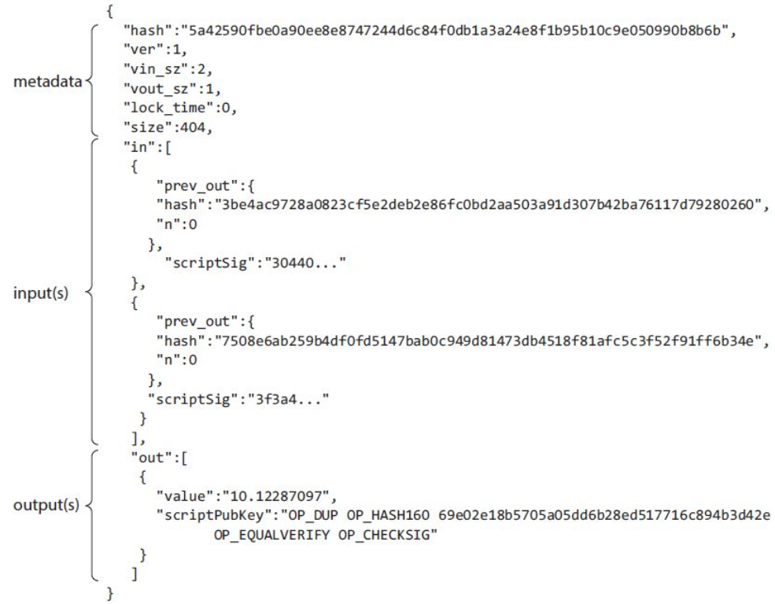
Transaction Syntax

Slide 10
Coinbase Transaction
New coins are created in Bitcoin with this transaction.
single input, single output.
The input contains a null hash pointer
The value of the output is currently (2015) around 25 BTC.
a flat mining reward: set by the system; halves every 210,000 blocks
the TX fees: collected from every TX included in the block.
coinbase parameter: completely arbitrary

Slide 11
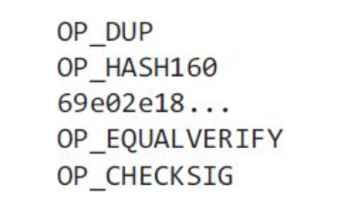
Bitcoin Scripting Language
The most common type of TX in Bitcoin: redeem a previous TX output by signing with the correct key
“this can be redeemed by a public key that hashes to X, along with a signature from the owner of that public key”
Pay-to-PubkeyHash script

Slide 12
Bitcoin Scripting Language
What happens to this script?
The inputs contain scripts instead of signatures.
Combine the new TX’s input script and the earlier TX’s output script
The resulting script must run successfully for the TX to be valid
These two scripts are scriptSig and scriptPubKey
scriptSig + scriptPubKey
The scripting language is stack-based: instruction executed linearly

Slide 13
Executing a Script
We need a stack that we can push data to and pop data from.
Two types of instructions: data instructions and opcodes.
data instruction: push data onto the top of the stack.
Opcodes: perform some function with input data on top of the stack
Execution of a Bitcoin Script
The first two instructions in this script are data instructions
OP_DUP: push a copy of the public key onto the top of the stack
OP_HASH160: pop value, compute hash, push the result

Slide 15
Bitcoin Blocks
Reach consensus on each TX? The rate is too low.
A hash chain of blocks is much shorter than a hash chain of TXs
a large number of TXs can be put into each block.
Blockchain is a combination of two hash-based data structures.
hash chain of blocks: Each block has a block header, a hash pointer to some TX data, and a hash pointer to the previous block
The header contains information related to the mining puzzle
the hash of the header of a valid block has to start with a large number of zeros
the header also contains: a nonce, a timestamp, and bits
only the header is hashed during mining
to verify a chain of blocks, all we need to do is look at the headers
Merkle tree: a per-block tree of all TXs included in that block
the root of the tree is the only TX data included in a block header

Slide 16
Bitcoin Blocks

